Slide 1
FINITE STATE AUTOMATA

Slide 2
FINITE STATE MACHINE
Many kinds of machines, including components in computers, can be modeled using a structure called a finite-state machine.
Finite-state machines include a finite set of states, with a designated starting state, an input alphabet, and a transition function that assigns a next state to every state and input pair.
Finite-state machines are used extensively in applications in computer science
and data networking.
For example, finite-state machines are the basis for programs for spell checking, grammar checking, indexing or searching large bodies of text, recognizing speech, transforming text using markup languages such as XML and HTML, and network protocols that specify how computers communicate.

Slide 3
EXAMPLE: VENDING MACHINE
A vending machine accepts 5 cents, 10 cents, and 25 cents. When a total of 30 cents or more has been deposited, the machine immediately returns the amount in excess of 30 cents.
When 30 cents has been deposited and any excess refunded, the customer can push an orange button and receive an orange juice or push a red button and receive an apple juice.

Slide 4
EXAMPLE: VENDING MACHINE
The machine can be in any of seven different states si, i = 0, 1, 2, . . . , 6, where si is the state where the machine has collected 5i cents. The machine starts in state s0, with 0 cents received.
The possible inputs are 5 cents, 10 cents, 25 cents, the orange button (O), and the red button (R).
The possible outputs are nothing (n), 5 cents, 10 cents, 15 cents, 20 cents, 25 cents, an orange juice, and an apple juice.

Slide 5
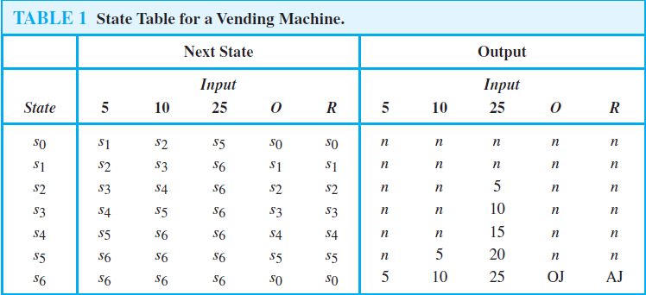
EXAMPLE: VENDING MACHINE

Slide 6
EXAMPLE: VENDING MACHINE
Suppose that a student puts in 10 cents followed by 25 cents, receives 5 cents back, and then pushes the orange button for an orange juice. The machine starts in state s0.
The first input is 10 cents, which changes the state of the machine to s2 and gives no output.
The second input is 25 cents. This changes the state from s2 to s6, and gives 5 cents as output. The next input is the orange button, which changes the state from s6 back to s0 (because the machine returns to the start state) and gives an orange juice as its output.

Slide 7
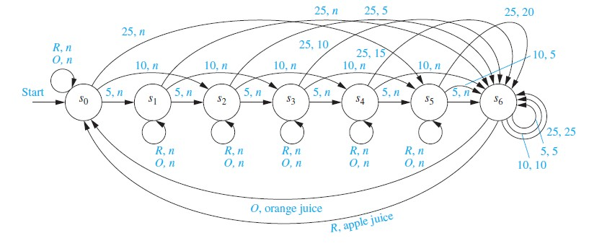
EXAMPLE: VENDING MACHINE
State Diagram

Slide 8
FINITE STATE MACHINE (WITH OUTPUT)
Definition:
A finite-state machine M = (S, I,O, f, g, s0) consists of a finite set S of states, a finite input alphabet I, a finite output alphabet O, a transition function f that assigns to each state and input pair a new state, an output function g that assigns to each state and input pair an output, and an initial state s0.

Slide 9
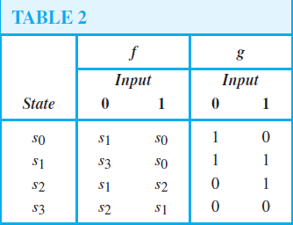
FINITE STATE MACHINE
The state table shown in Table 2 describes a finite-state machine with S = {s0, s1, s2, s3},I = {0, 1}, and
O = {0, 1}. The values of the transition function f are displayed in the first two columns, and the values of the output function g are displayed in the last two columns.
Construct the state diagram for the finite-state machine with the state table shown in Table 2.

Slide 10
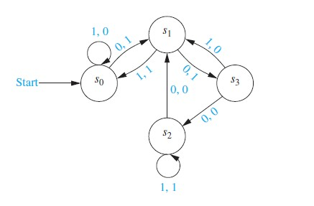
FINITE STATE MACHINE

Slide 11
FINITE STATE AUTOMATA (FSM WITH NO OUTPUT)
DEFINITION:
A finite-state automaton M = (S, I, f, s0, F) consists of a finite set S of states, a finite input alphabet I, a transition function f that assigns a next state to every pair of state and input (so that f : S × I → S), an initial or start state s0, and a subset F of S consisting of final (or accepting states).

Slide 12
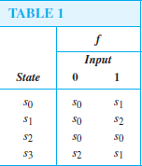
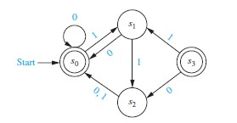
FINITE STATE AUTOMATA

Slide 13
Types of FSA
Deterministic
for each pair of state and input value there is a unique next state given by the transition function.
Non deterministic
there may be several possible next states for each pair of input value and state.

Slide 14
NON DETERMINISTIC FSA
DEFINITION:
A nondeterministic finite-state automaton M = (S, I, f, s0, F) consists of a set S of states, an input alphabet I, a transition function f that assigns a set of states to each pair of state and input (so that f : S × I → P(S)), a starting state s0, and a subset F of S consisting of the final states.

Slide 15
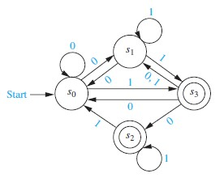
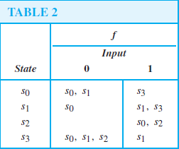
NON DETERMINISTIC FSA

Slide 16
LANGUAGE RECOGNITION
We have seen that finite-state automata can be used as language recognizers.
There is a simple characterization of the sets that can be recognized by finite state automata.
They are called Regular Sets.
Can be formed using the operations of concatenation, union and Kleene closure in arbitrary order, starting with the empty set, the empty string, and singleton sets.
To define regular sets, we first need to define regular expressions.
Kleene’s Theorem: A set is regular if and only if it is recognized by a finite-
state automaton.

Slide 17
Regular Expressions
Each regular expression represents a set specified by these rules:
Ø = the empty set (set with no strings);
λ = the set {λ}, which is the set containing the empty string;
x = the set {x}, containing the string with one symbol x;
(AB) = the concatenation of the sets represented by A and by B;
(A U B) = the union of the sets represented by A and by B;
A* = the Kleene closure of the set represented by A.

Slide 18
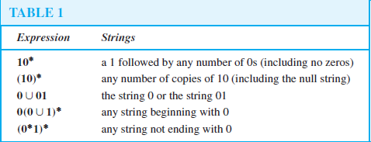
Regular Expressions
Example:
What are the strings in the regular sets specified by the regular expressions 10*, (10*), 0 U 01, 0(0 U 1)*, and (0*1)* ?
Solution:

